Slide 1
DATAQUEST HACKATHON
By,
Abhishek kumar singh

Slide 2
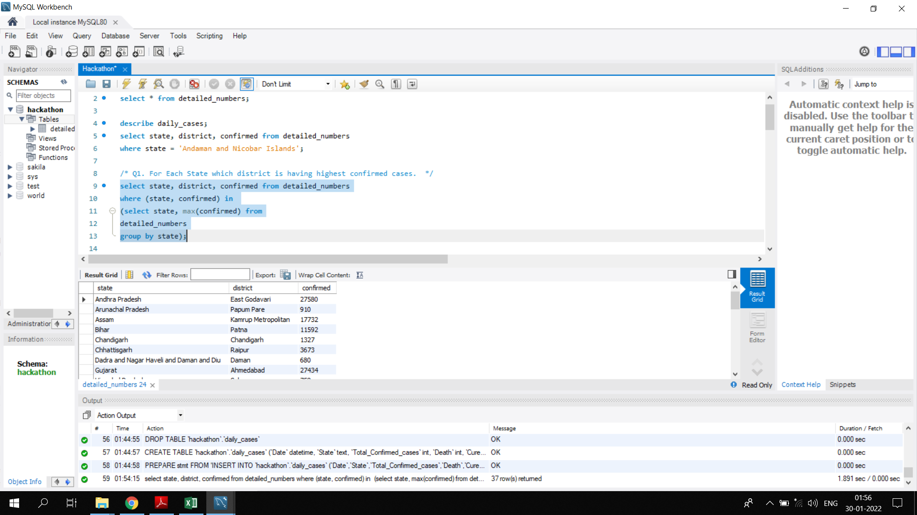
PROBLEM STATEMENTS 1. For Each State which district is having highest confirmed cases.

Slide 3
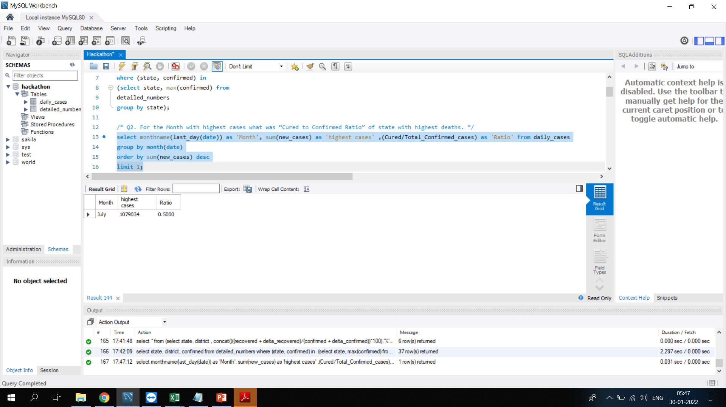
2. For the Month with highest cases what was “Cured to Confirmed Ratio” of state with highest deaths.

Slide 4
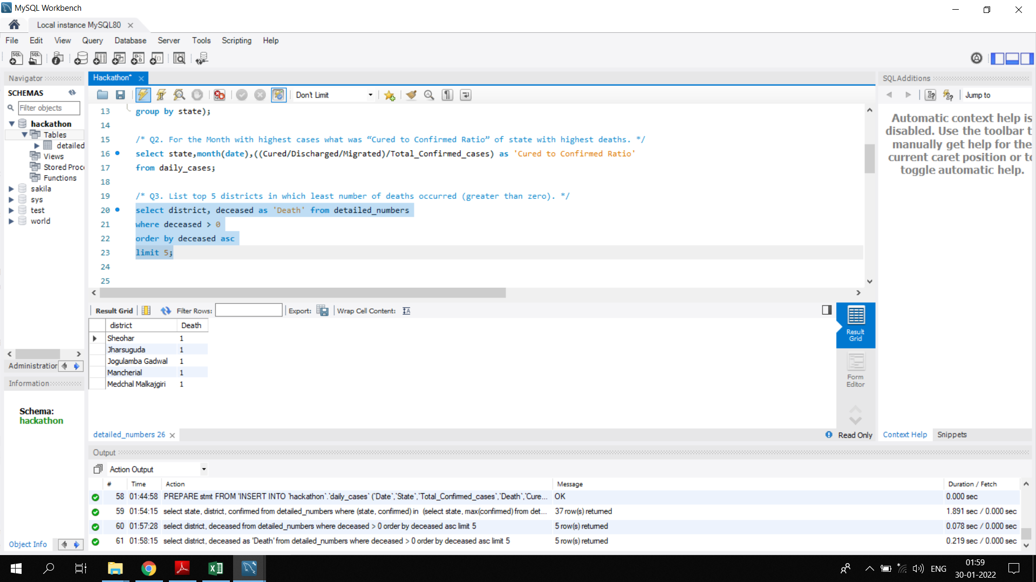
3. List top 5 districts in which least number of deaths occurred (greater than zero).

Slide 5
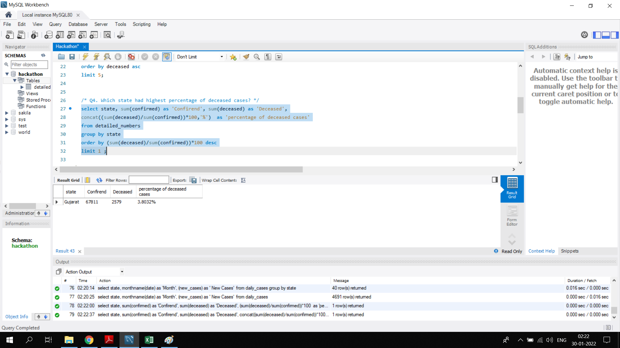
4. Which state had highest percentage of deceased cases?

Slide 6
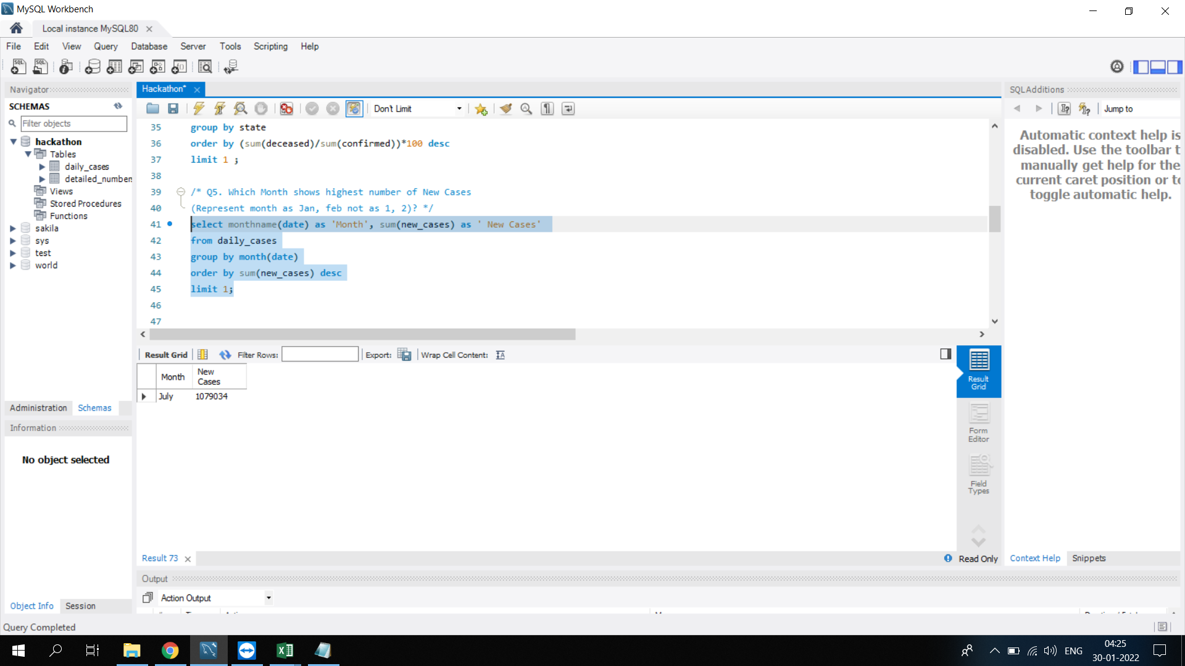
5. Which Month shows highest number of New Cases (Represent month as Jan, feb not as 1, 2)?

Slide 7
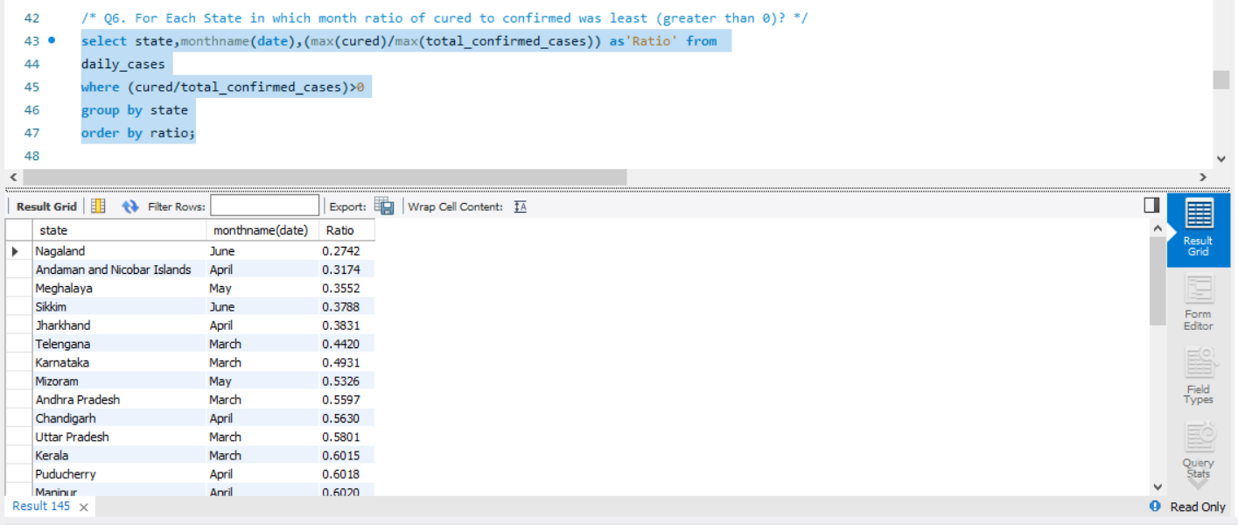
6. For Each State in which month ratio of cured to confirmed was least (greater than 0)?

Slide 8
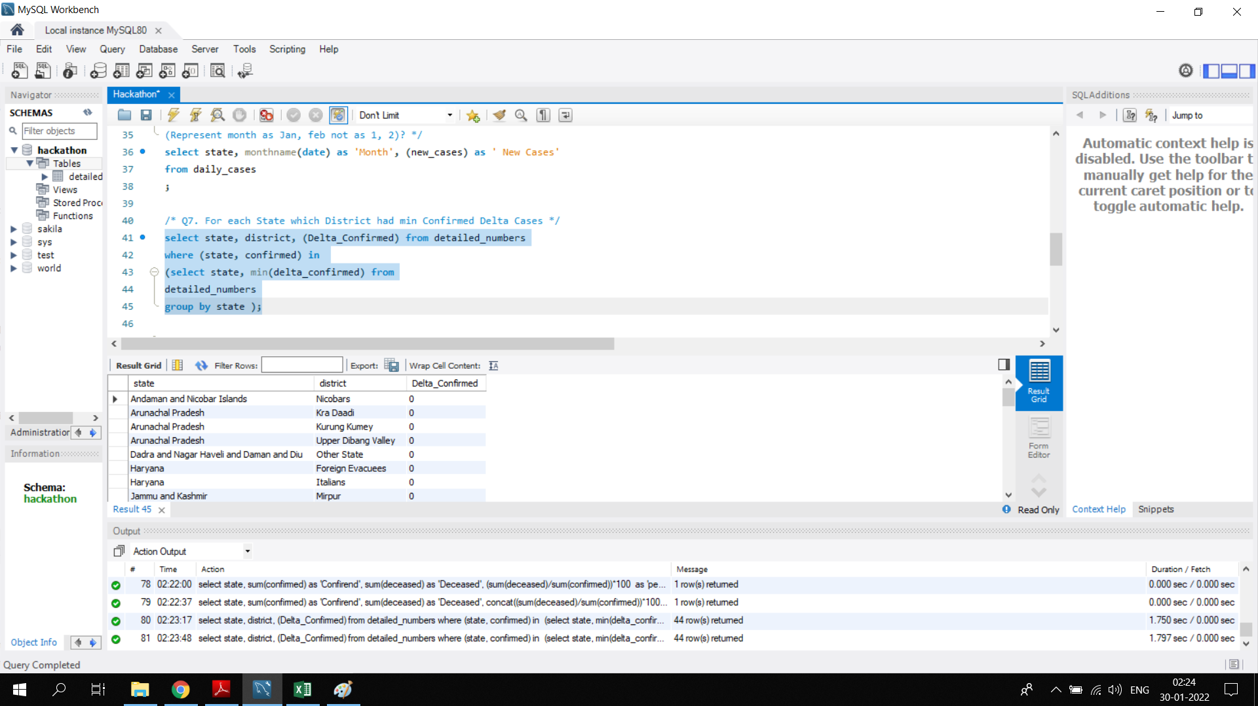
7. For each State which District had min Confirmed Delta Cases.

Slide 9
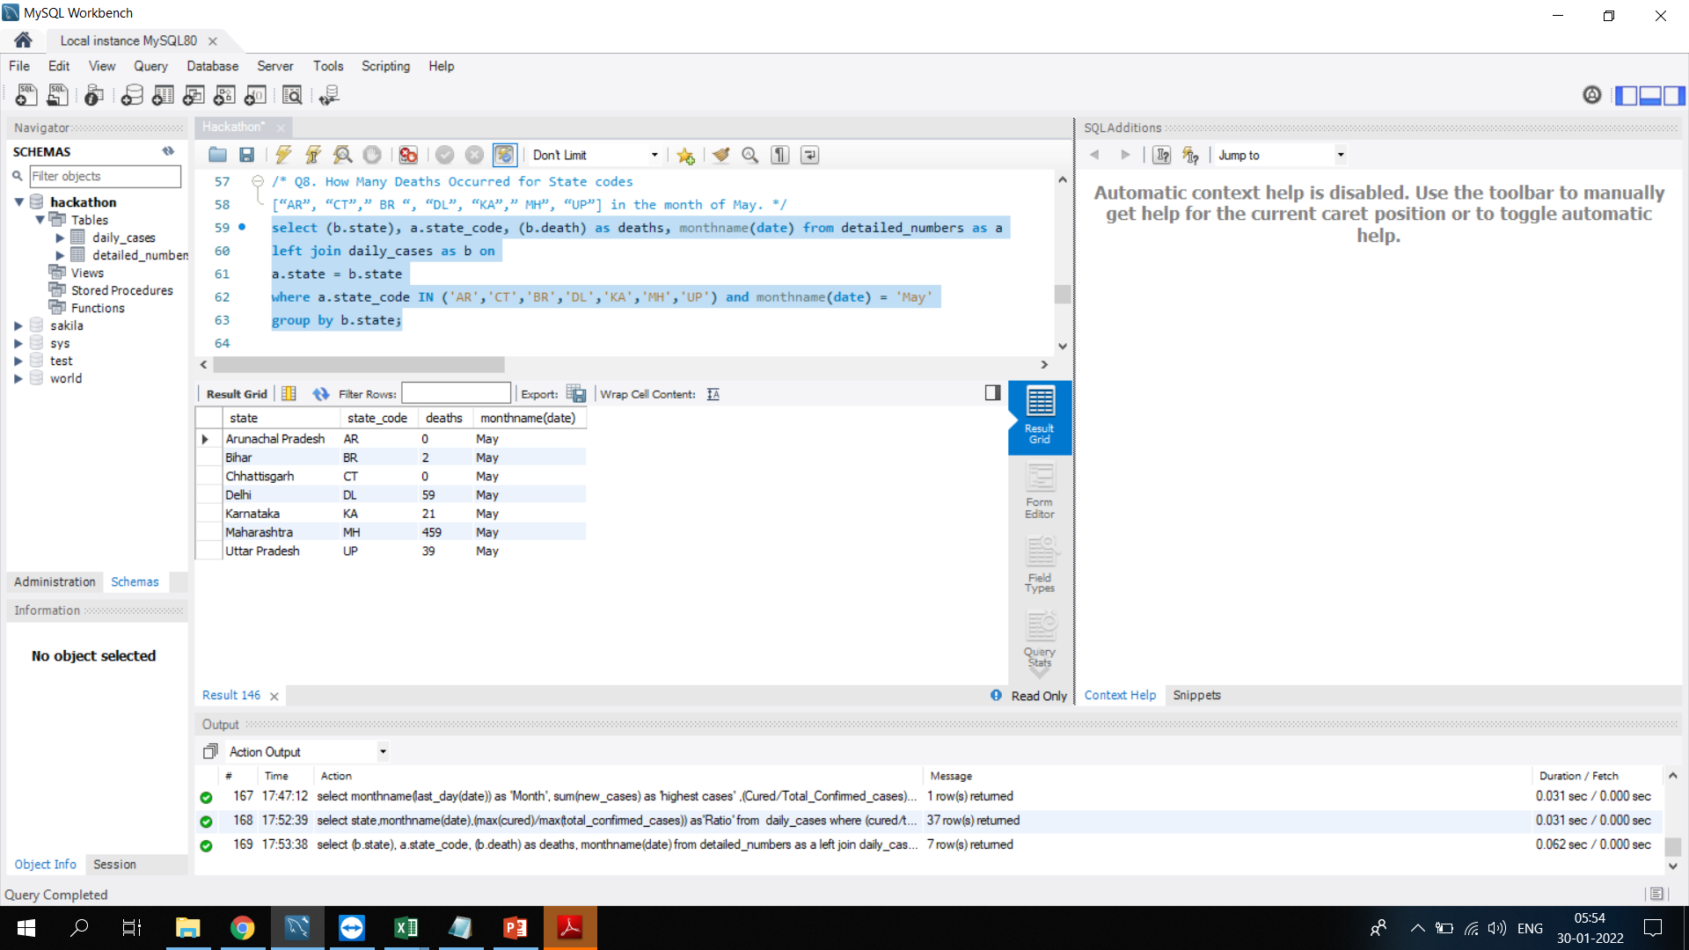
8. How Many Deaths Occurred for State codes [“AR”, “CT”,” BR “, “DL”, “KA”,” MH”, “UP”] in the month of May.

Slide 10
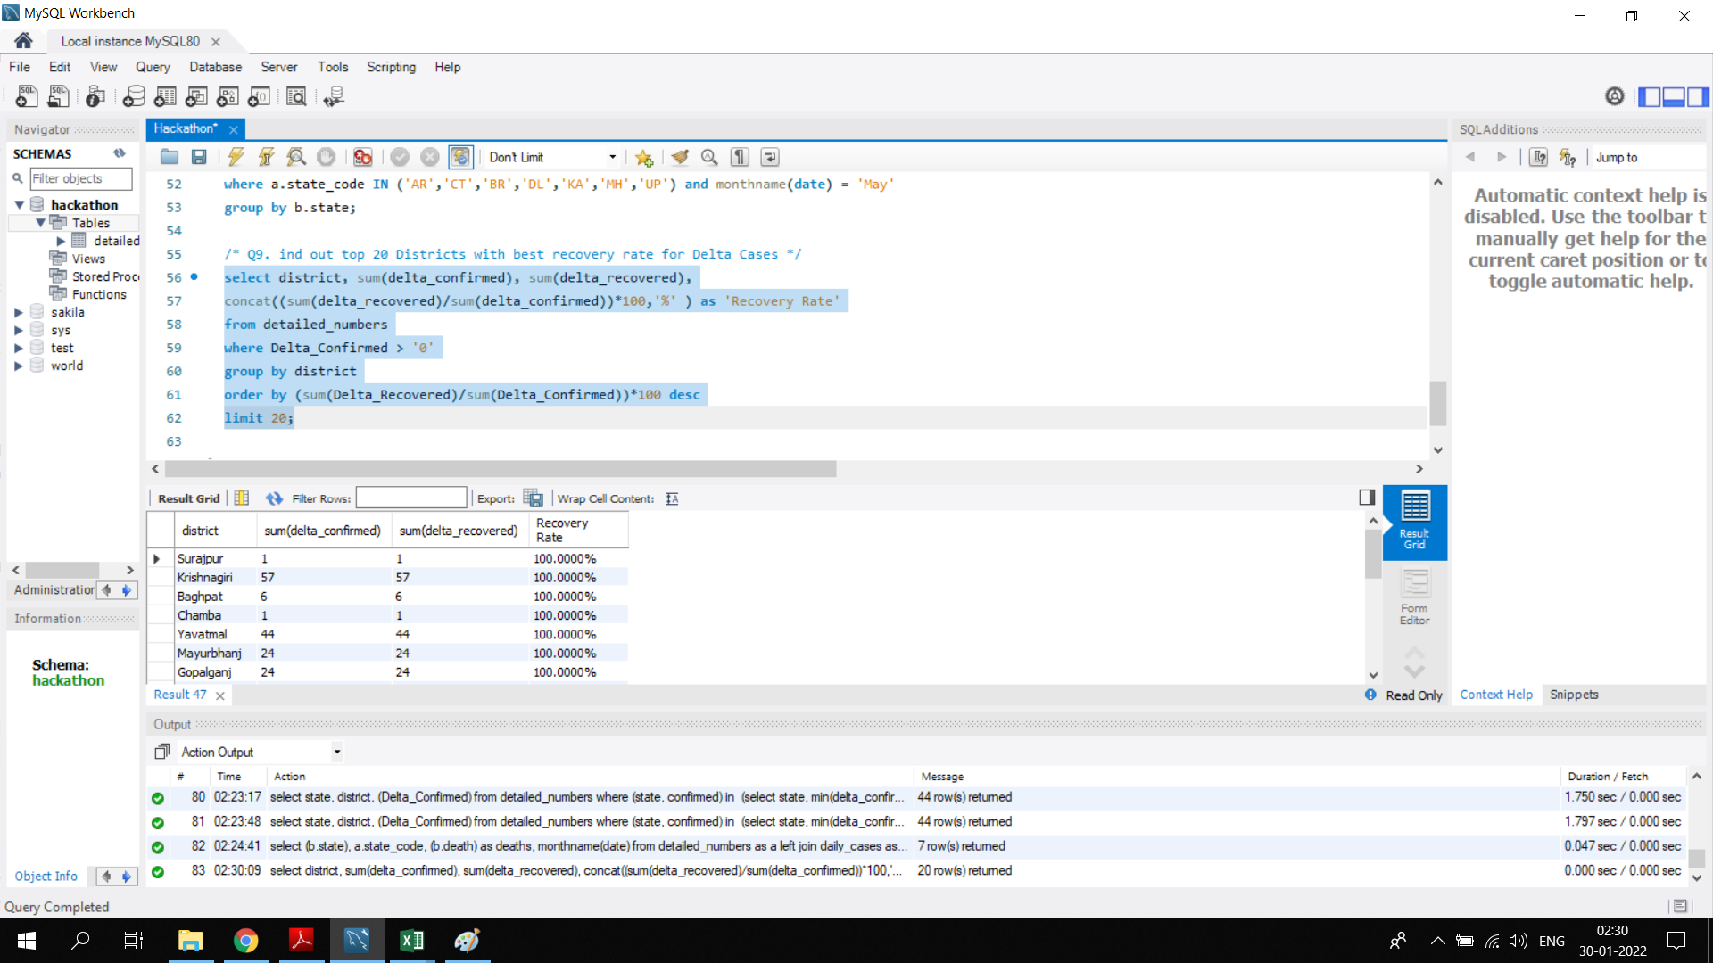
9. Find out top 20 Districts with best recovery rate for Delta Cases.

Slide 11
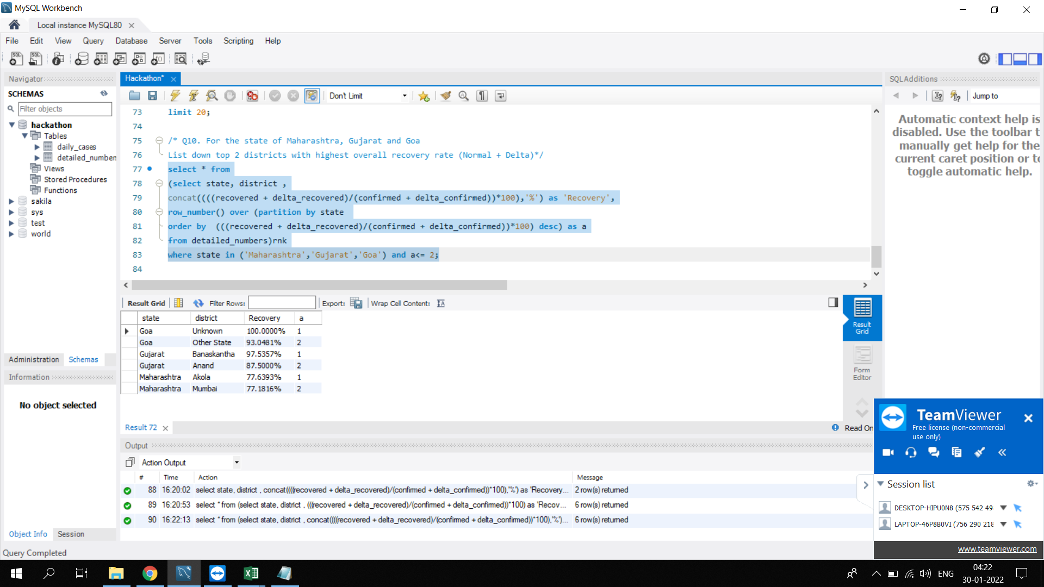
10. For the state of Maharashtra, Gujarat and Goa List down top 2 districts with highest overall recovery rate (Normal + Delta).

Slide 12
THANK YOU.

